Slide 1
Analog and Digital

Slide 2

Note
To be transmitted, data must be transformed to electromagnetic signals.

Slide 3
ANALOG AND DIGITAL
The term analog data refers to information that is continuous.
The term digital data refers to information that has discrete states.
Analog data take on continuous values.
Digital data take on discrete values.

Slide 4
Analog and Digital Data
Data can be analog or digital.
Analog data are continuous and take continuous values.
Digital data have discrete states and take discrete values.

Slide 5
Analog and Digital Signals
Signals can be analog or digital.
Analog signals can have an infinite number of values in a range.
Digital signals can have only a limited number of values.

Slide 6
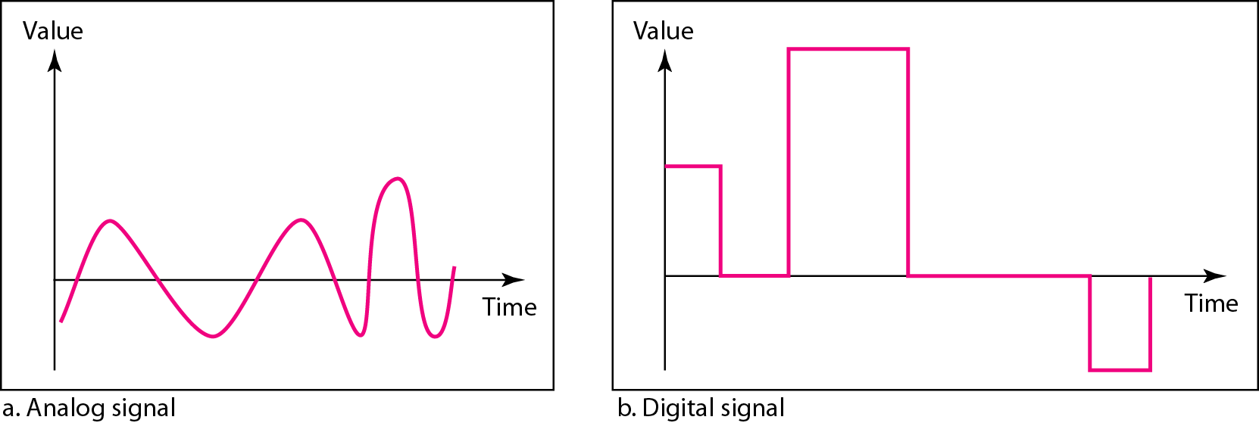
Comparison of analog and digital signals

Slide 7
ANALOG SIGNALS CHARACTERISTICS
A periodic signal completes a pattern within a measurable time frame, called a period, and repeats that pattern over subsequent identical periods.
The completion of one full pattern is called a cycle.
A nonperiodic signal changes without exhibiting a pattern or cycle that repeats over time.

Slide 8
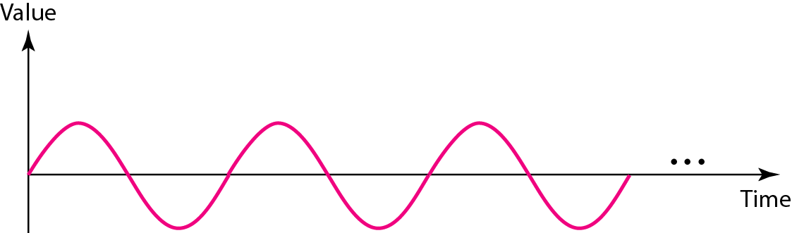
A sine wave(periodic signal )

Slide 9
A sine wave(periodic signal )
A sine wave can be represented by three parameters:
the peak amplitude
the frequency, and
the phase.
These three parameters fully describe a sine wave.

Slide 10
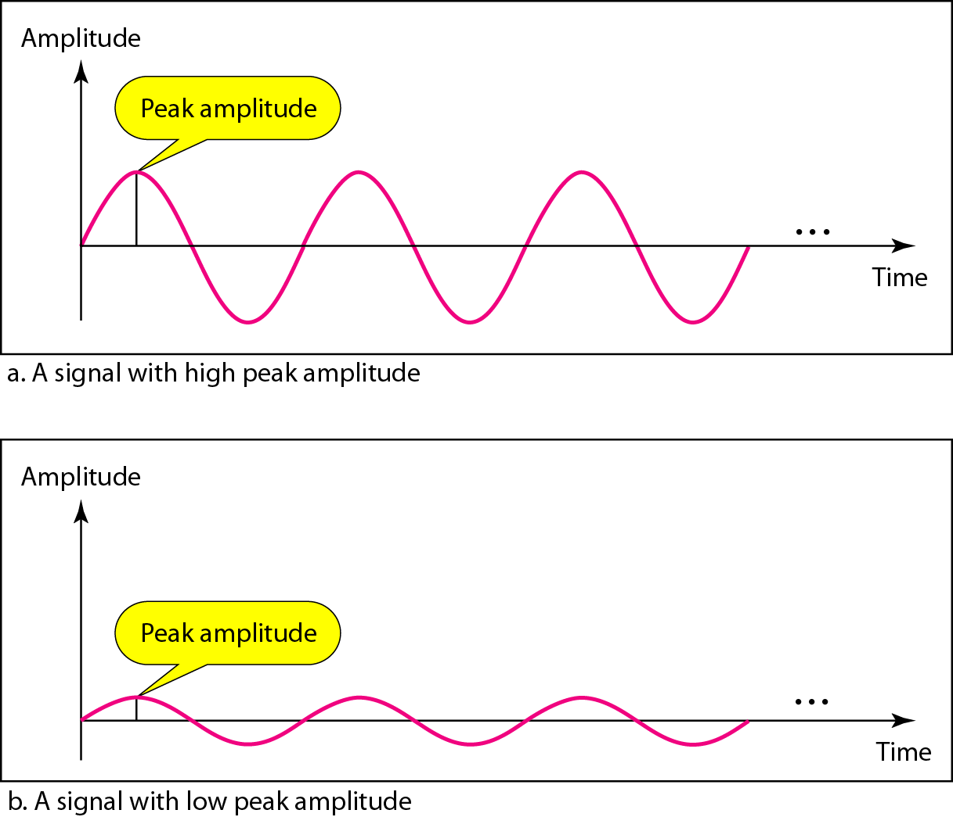
Two signals with the same phase and frequency, but different amplitudes

Slide 11

Note
Frequency and period are the inverse of each other.

Slide 12
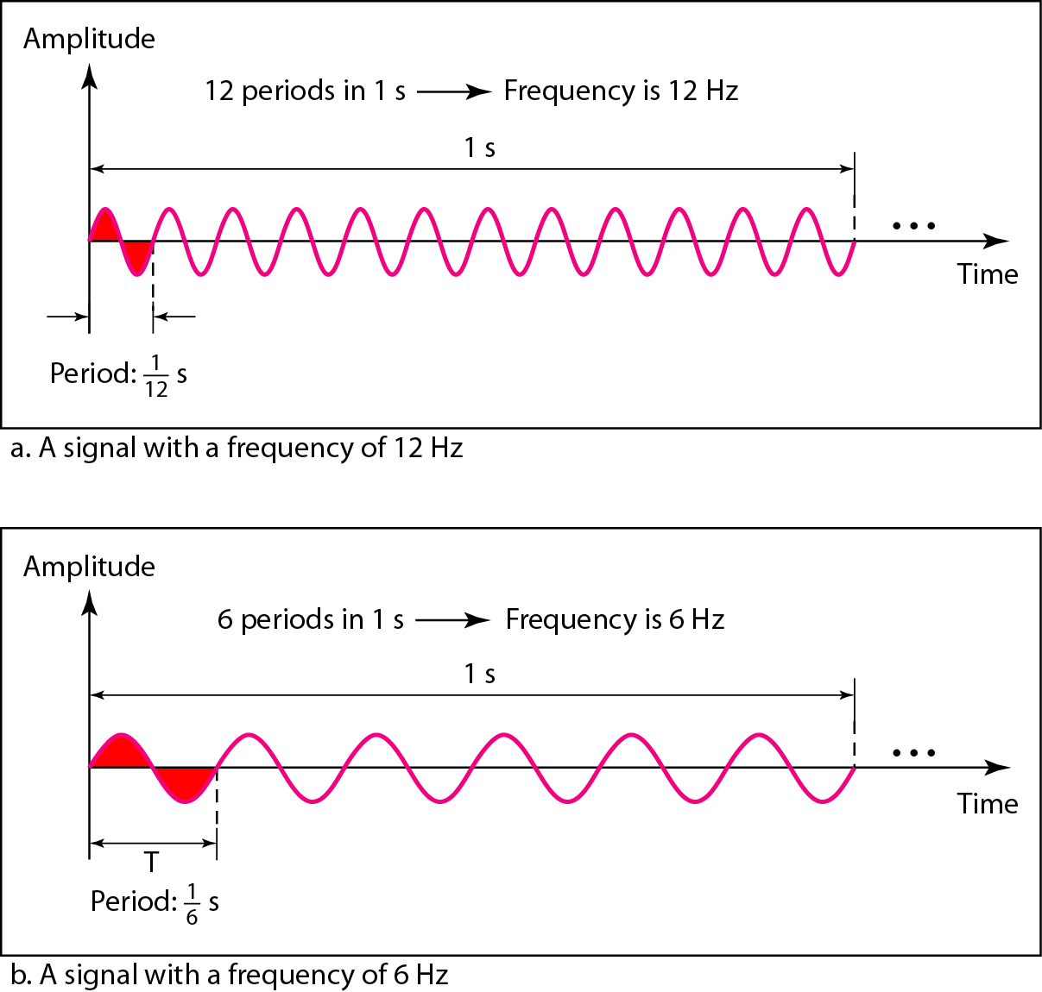
Two signals with the same amplitude and phase, but different frequencies

Slide 13
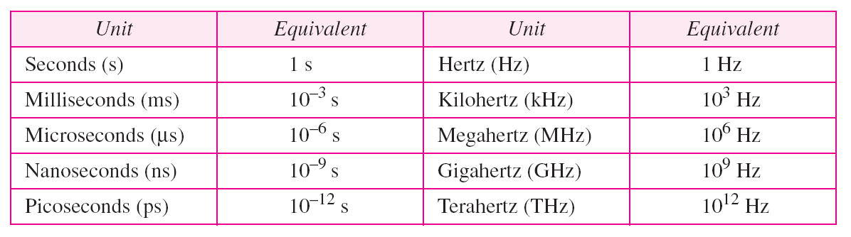
Units of period and frequency

Slide 14
Example
The power we use at home has a frequency of 60 Hz. The period of this sine wave can be determined as follows:

Slide 15
Example
The power we use at home has a frequency of 60 Hz. The period of this sine wave can be determined as follows:

Slide 16
Example
The period of a signal is 100 ms. What is its frequency in kilohertz?

Slide 17
Example
The period of a signal is 100 ms. What is its frequency in kilohertz?
Solution
First we change 100 ms to seconds, and then we calculate the frequency from the period (1 Hz = 10⁻³ kHz).

Slide 18
Note
Phase describes the position of the waveform relative to time 0.

Slide 19
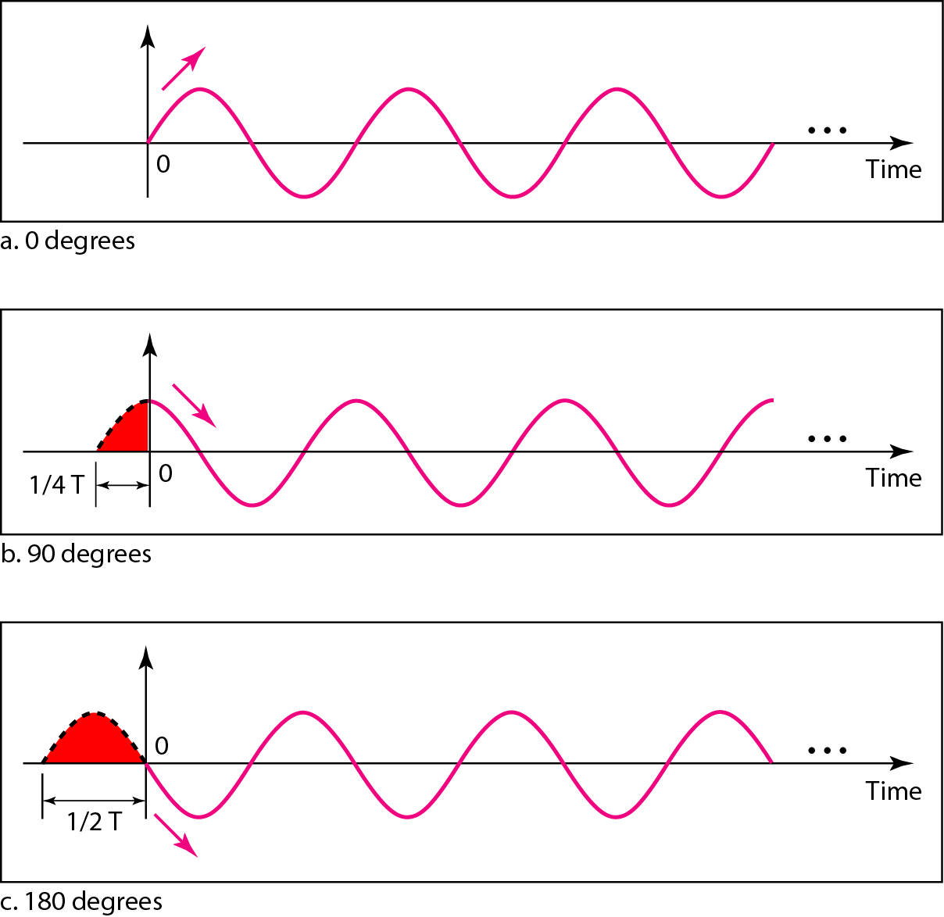
Figure Three sine waves with the same amplitude and frequency, but different phases

Slide 20
Example
A sine wave is offset 1/6 cycle with respect to time 0. What is its phase in degrees and radians?
Solution
We know that 1 complete cycle is 360°. Therefore, 1/6 cycle is

Slide 21
Example
A sine wave is offset 1/6 cycle with respect to time 0. What is its phase in degrees and radians?
Solution
We know that 1 complete cycle is 360°. Therefore, 1/6 cycle is

